Slide 1
Using Computational Thinking in Biology and Social Science Research
Heloisa Milioli
Shannon Fenn
PhD student
in Biological Sciences
PhD student
in Computer Science

Slide 2
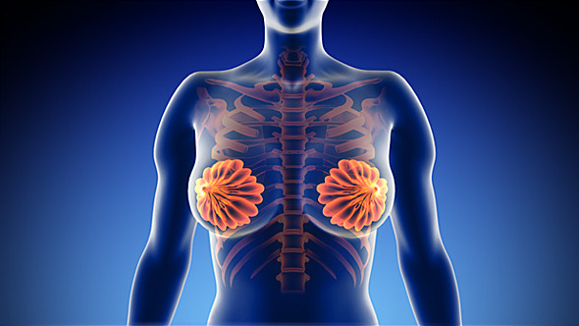
Biomarker Discovery in Breast Cancer
Heloisa Helena Milioli
Faculty of Science and Information Technology
School of Environmental and Life Sciences
Notes:
Title page (option 1)
This is the slide that will remain until the presentation starts.
Please note that the image on this slide can be replaced with an image relevant to your presentation. The image should be resized to the following dimensions: 23.8 cm (w) x 17.4 cm (h)

Slide 3
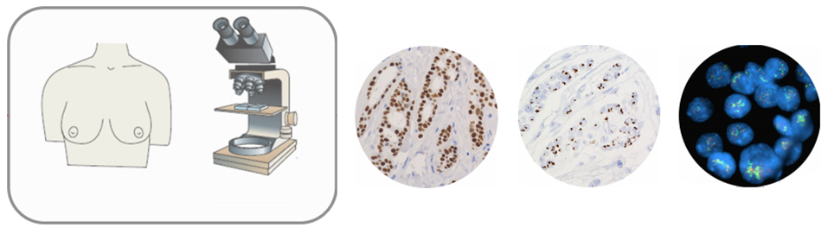
Background
Clinical Information
Clinical
Pathological
ER and PR
HER2
HER2
Molecular subtypes:
Luminal A
Luminal B
Her2-enriched
Normal-like
Basal-like
Histological type
Grade
Stage (TNM)
Receptor status: ER, PR, HER2
Molecular features
Notes:
Pull Quote / Key Message Slide
This slide has been design for testimonial quotes, key messages or extracts, which the presenter wishes to highlight in their presentation.
It is only meant for small amounts of copy, no images.

Slide 4
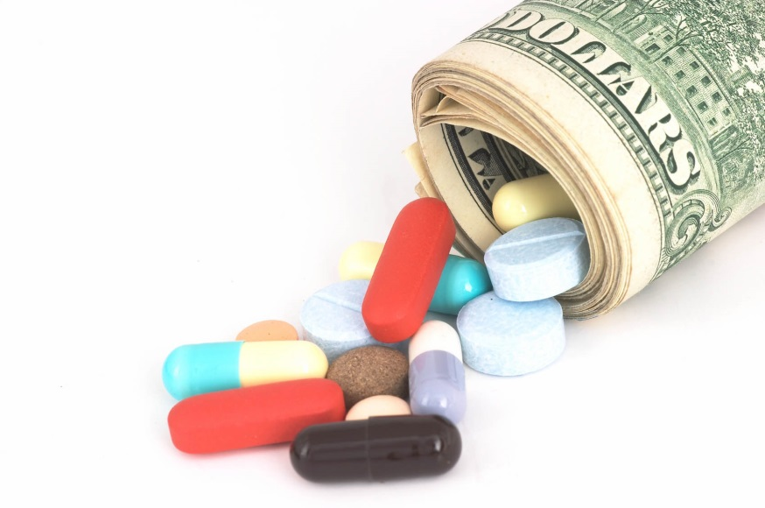

Treatment
Data set:
- 2,000 breast cancer samples
- 48,803 transcripts (genes and other RNAs)

Slide 5
Intrinsic Subtypes
Figure 1. The gene expression profile of the balanced top ten probes selected for each of the five breast cancer intrinsic subtypes
Notes:
Table Slide
Above is a generic table page with a heading.
To insert a table:
Click on the table icon shown in the centre of the slide.
Enter the number of rows and columns you require, The top menu bar will change, highlighting the variety of tables available. You will find that the tables are aligned with the UON colour palette.
Choose the table that best suits your needs and enter your data.

Slide 6
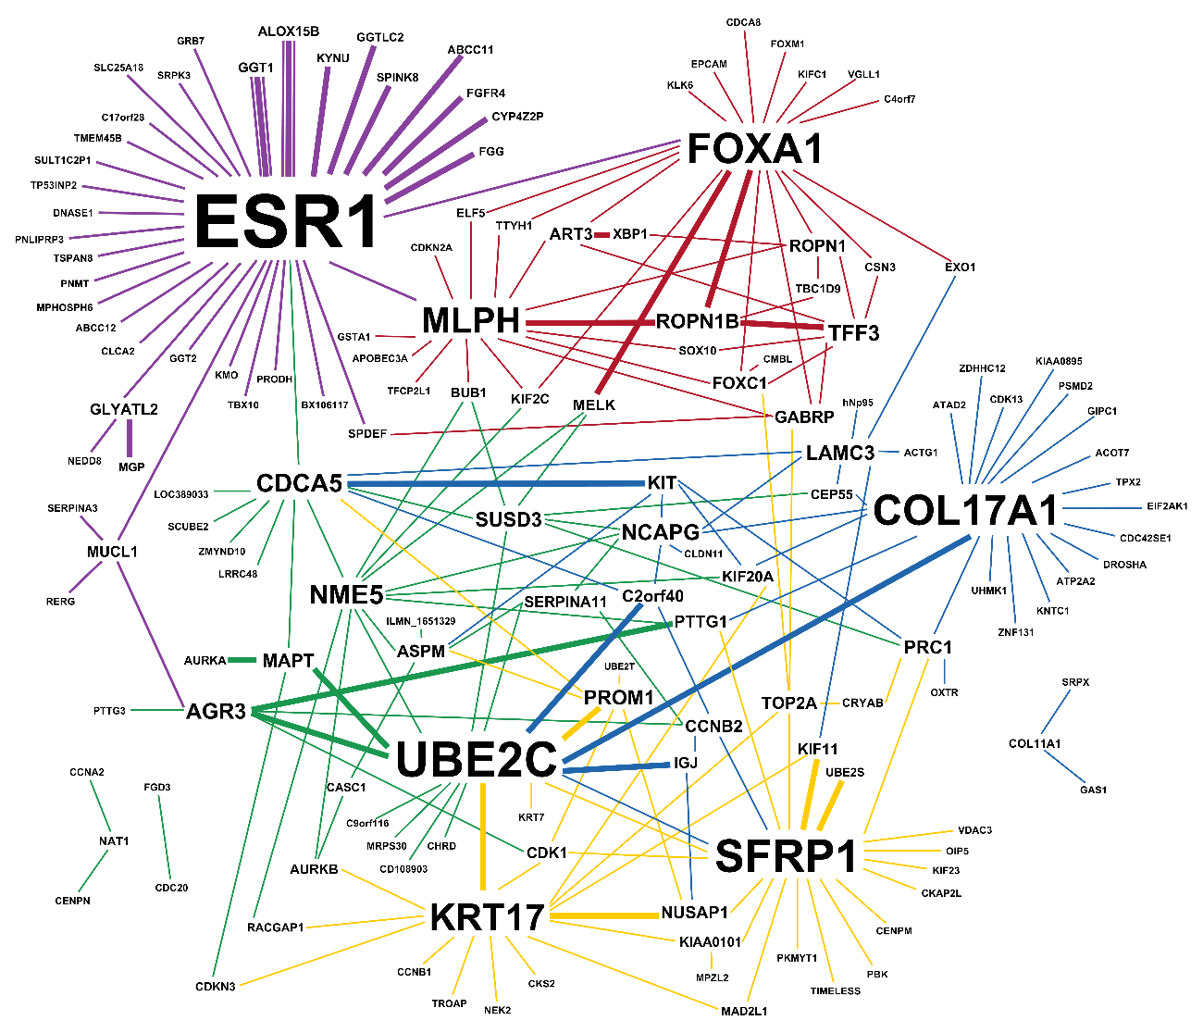
Intrinsic Features
Figure 3. Meta-features selected with the CM1 score in the METABRIC discovery set

Slide 7
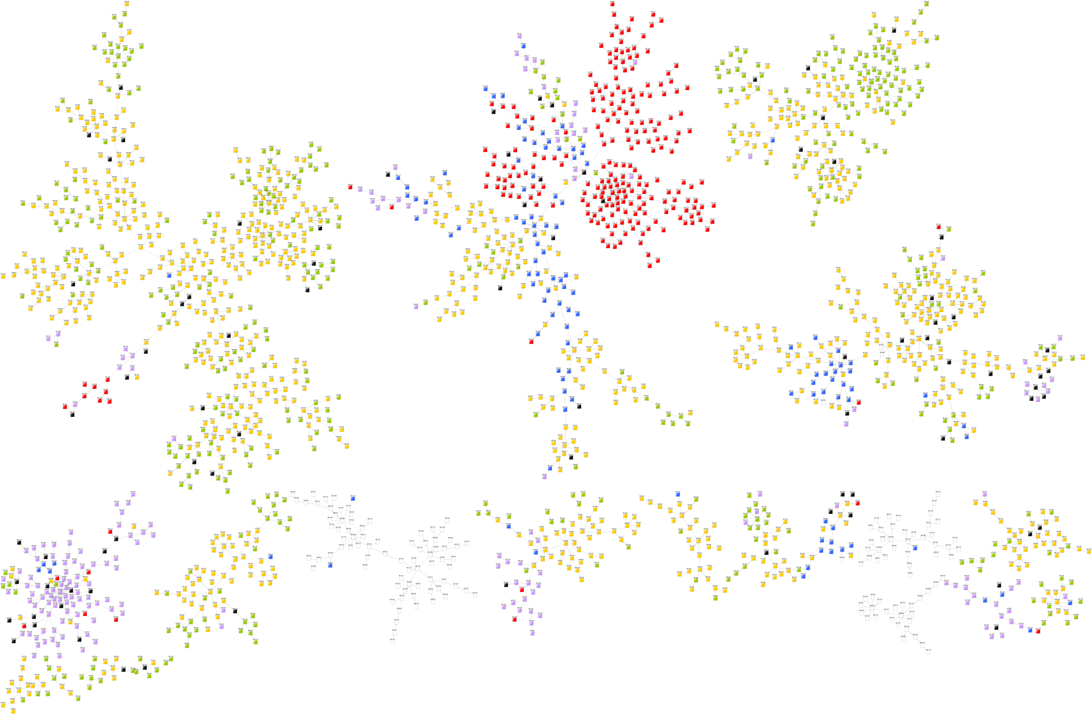
Cluster of Samples
Luminal A
Luminal B
Her2
Normal-like
Basal
Controls
Figure 2. MST-kNN clustering.
Discovery and Validation

Slide 8
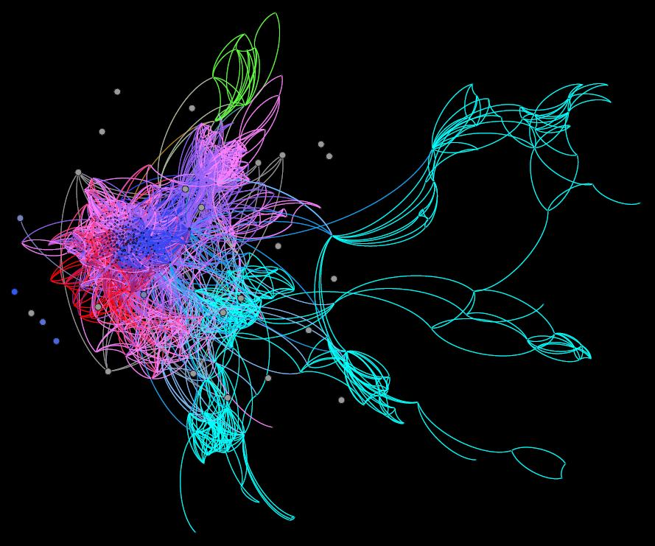
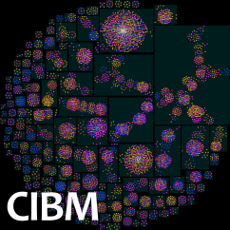
Lessons for AI from the Classroom
Methods for automatic curricula
Shannon Fenn
Faculty of Engineering and Built Environment
School of Electrical Engineering and Computer Science

Slide 9



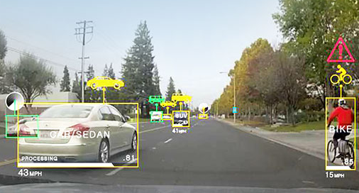

Slide 10
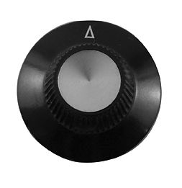
?
$
Size
Suburb
Yard?
Pool?
# Bedrooms

Slide 11
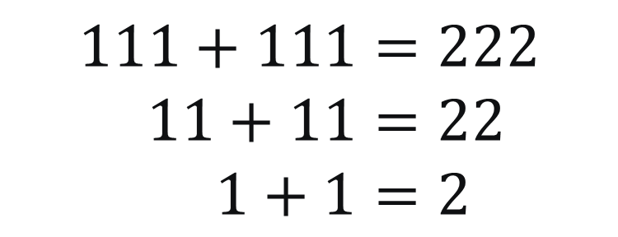
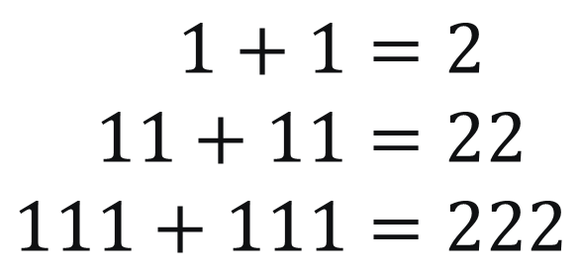
$$1+1=2 \\ 11+11=22 \\ 111+111=222$$
OR
$$111+111=222 \\ 11+11=22 \\ 1+1=2$$

Slide 12
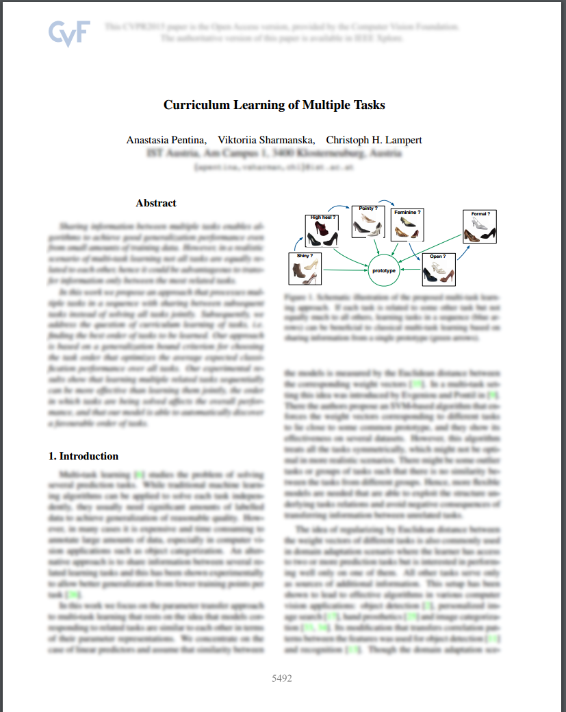
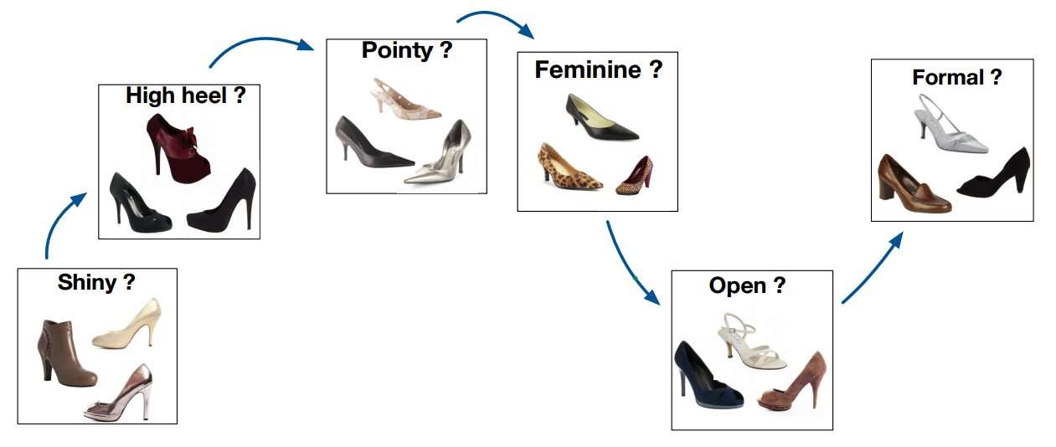

Slide 13
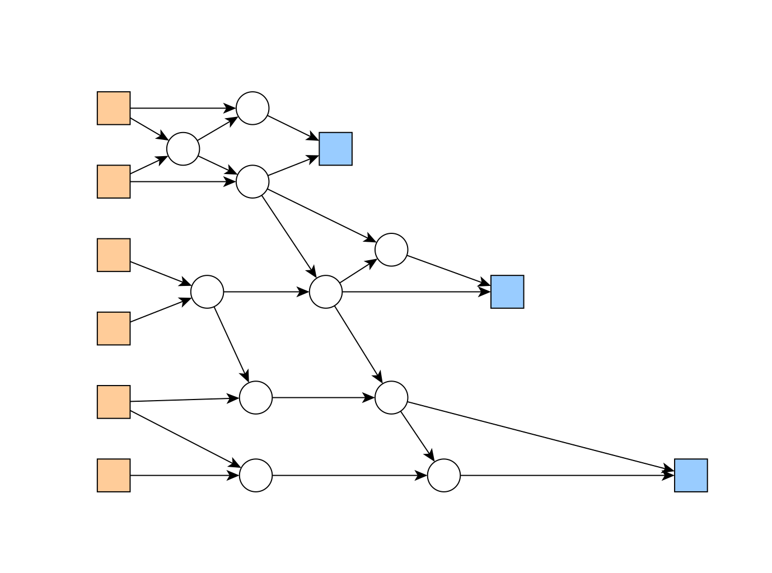
Height
Overweight?
Weight
Chest pain
Current Heart attack risk?
Sweating
Diabetes?
Future Heart attack risk?
Blood Press.

Slide 14
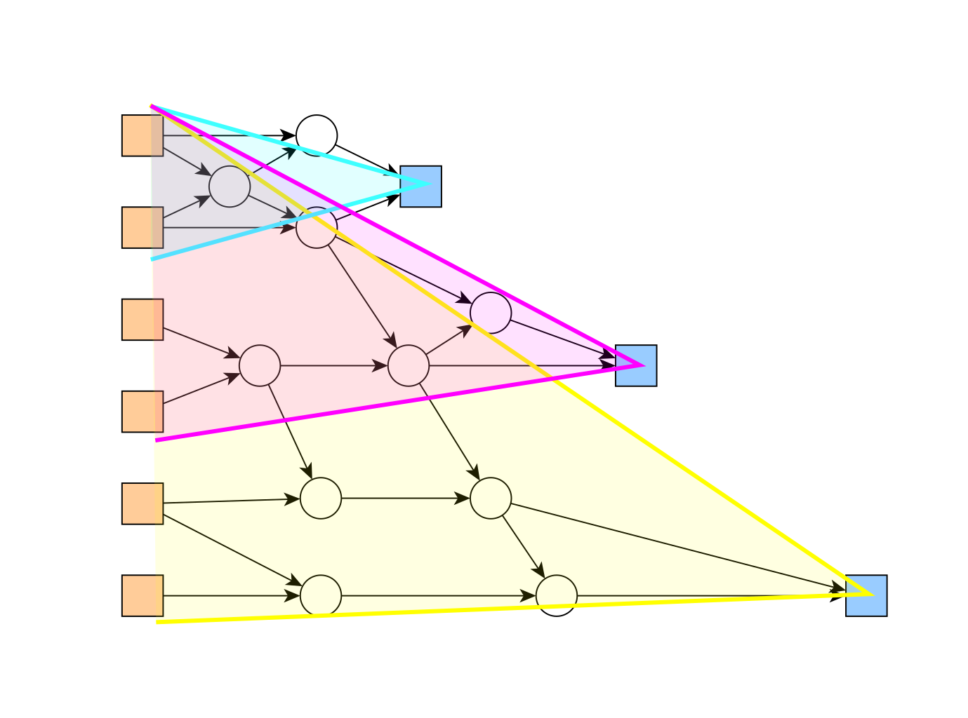

Slide 15
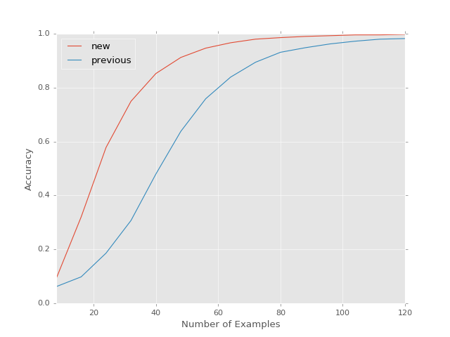

Slide 16

Notes:
Start with this slide on the screen during pre-presentation formalities.

